Slide 1

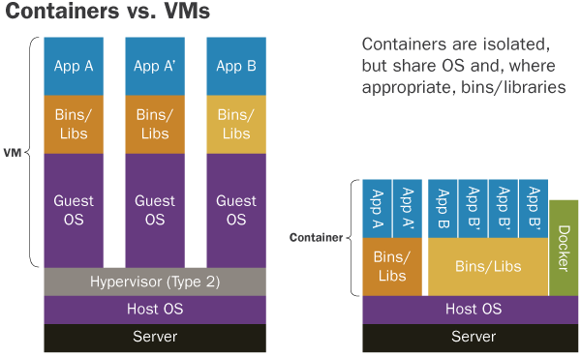
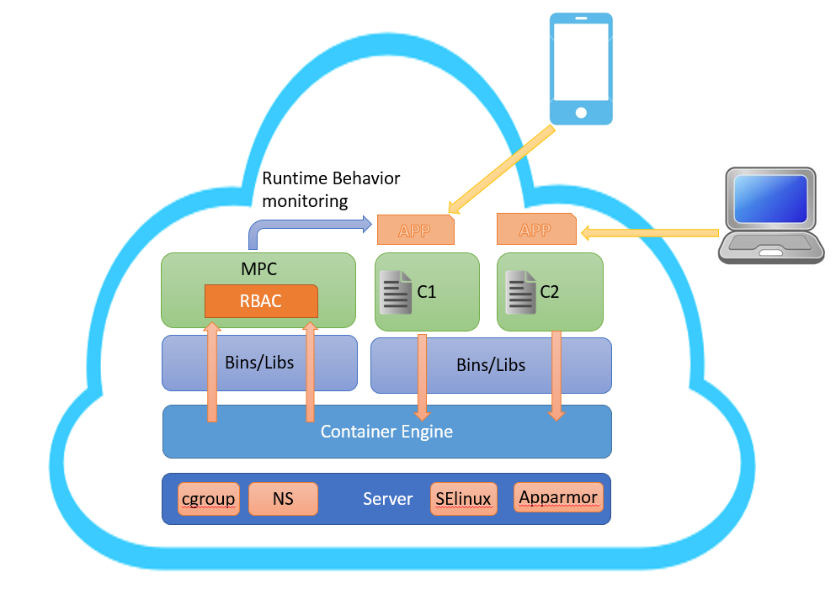
Secure Container Based Virtualization on Cloud using Improved Access Control Mechanism :RBAC
Vivek Vijay Sarkale ,Paul Rad
Department of Computer Science
Background
Secured Containerization on Cloud Platform with MPC
Why Containers?
Fig[1] : Containers [Ref: https://insights.sei.cmu.edu]
Security Vulnerabilities
Linux Kernel Exploit
Container Breakouts
Absence of Container behaviour monitor
Policy enforcement at upper layer of containerization
Most Privileged Container : Running all the time , defined policies using access control mechanism
Security profiles: Unified profile based on container resources requirement and behaviour
MPC: RBAC mechanism is used
Contains policy DB with the list of black listed containers
Overlook Security profile and behavior DB for every requesting container
Assign role (root , non-root) and permissions based on background check
Perform Runtime process monitoring
MPC can be implemented on any cloud platform to ensure security .E.g .Openstack Magnum: container as service solution
Contact Information
paul.rad@utsa.edu
viveksarkale@gmail.com
Notes:
54 x 36 poster
1” margins, 52 x 34 usable
125pt Title, 100pt Name and Org, 75pt Headings, 50pt Text
2 configurations: Golden Ratio (center piece is bigger) and 3 Equal pieces

